Slide 1
Introduction to BigData
Week-1
Begin your acquisition of Big Data knowledge with the most up-to-date definition of Big Data. You’ll explore the impact of Big Data on everyday personal tasks and business transactions with Big Data Use Cases. Learn how Big Data uses Parallel Processing, Scaling, and Data Parallelism. Learn about commonly used Big Data tools. Then, go beyond the hype and explore additional Big Data viewpoints.Describe IBM Cloudant, its key characteristics, and its key capabilities.
Learning Objectives
Define what Big Data is and identify key Big Data characteristics.
Provide examples of Big Data related technologies, describe the impact of Big Data on businesses and people, and define the relationship between the Internet of Things (IoT) and Big Data.
Compare linear to parallel processing and explain why Big Data requires parallel processing.
Describe scalability, including horizontal scaling, embarrassing parallel calculations, and fault tolerance as they relate to Big Data.
List the key Big Data ecosystem tooling categories and their associated major tools and vendors.
Explain the role of open-source in Big Data and list related platforms and open-source frameworks.
Describe the key sources and different types of Big Data.
Provide examples of real-world Big Data use cases.

Slide 2
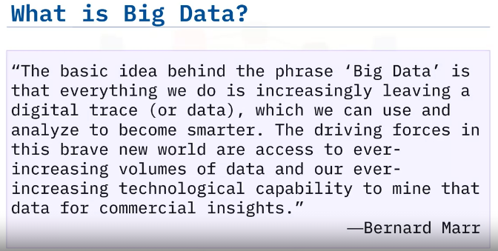
Big Data
identify the characteristics of Big Data
explain the five V’s of Big Data
What is Big Data?

Slide 3
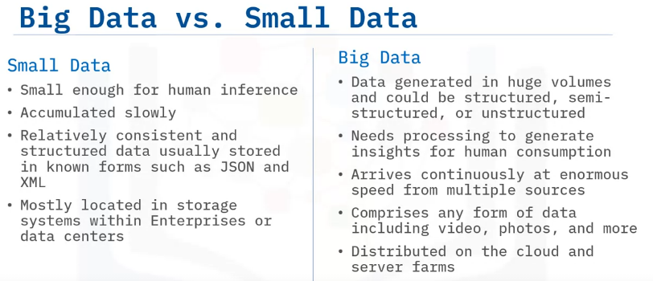
To understand Big Data, we need to compare it with Small Data.
Small Data is available in limited quantities that can be easily interpreted by humans with little or no digital processing.
Sports scores and employee shift schedules are some examples of Small Data.
It is accumulated slowly and may or may not get updated continuously.
Storing Small Data is relatively easy as it is mostly available in a structured format such as First and Last Name, Address, Gender, and so on, and It can be maintained within an enterprise’s own infrastructure or in a data center.
Big Data, on the other hand, is generated in massive volumes and has little or no structure in which it is received.
Examples of semi-structured data include social media posts that could be images accompanied by hashtags, while unstructured data could include medical records from millions of patients.
It is complex and requires specialized programs to interpret and make it available for human consumption.
Not only is Big Data massive in size, it is collected continuously and grows exponentially in a short amount of time.
Big Data could be in any form including but not limited to text, images, audio, and videos.
Finally, Big Data is so voluminous that it is stored in the Cloud or on server farms set up specifically for this purpose.

Slide 4
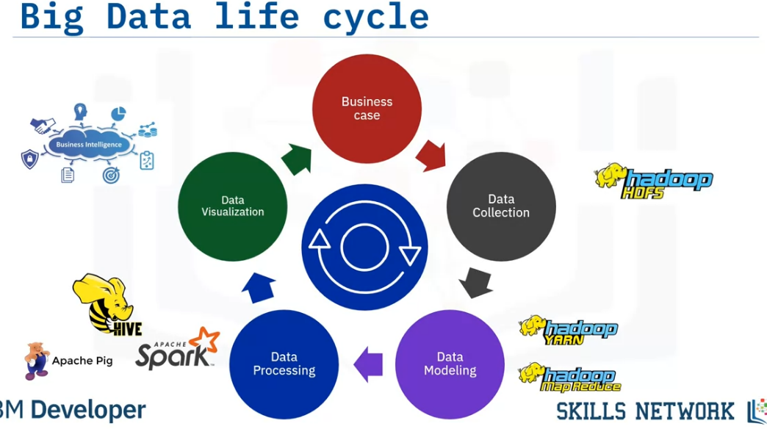
It is a common misconception that Big Data refers to just large volumes of data.
In reality, Big Data is the entire life cycle of working with large volumes of data.
Let’s take a look at each phase in the Big Data life cycle.
Big Data collection is initiated as a result of a business problem or requirement.
As data is collected, it gets stored using a framework for distributed storage such as Hadoop HDFS.
To make sense of all the data collected, Map and Reduce tasks and scripts create a data model to store it in a database.
This data model includes the various data entities (or objects), and the relationship and rules between these entities.
After modeling, data is ready to be processed.
Tools such as Apache Spark are used to produce meaningful information from the modeled data.
Finally, the processed data is visualized and presented in a graphical format such as charts and graphs.
This visualized data is then used for making meaningful business decisions and lead to new business cases, thereby creating a continuous life cycle.

Slide 5
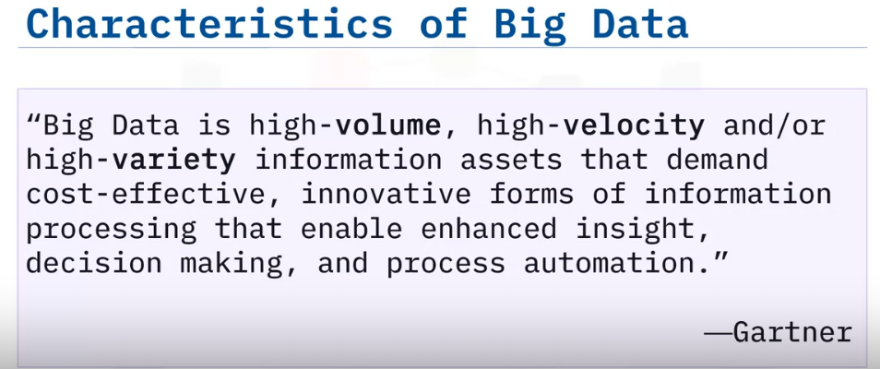
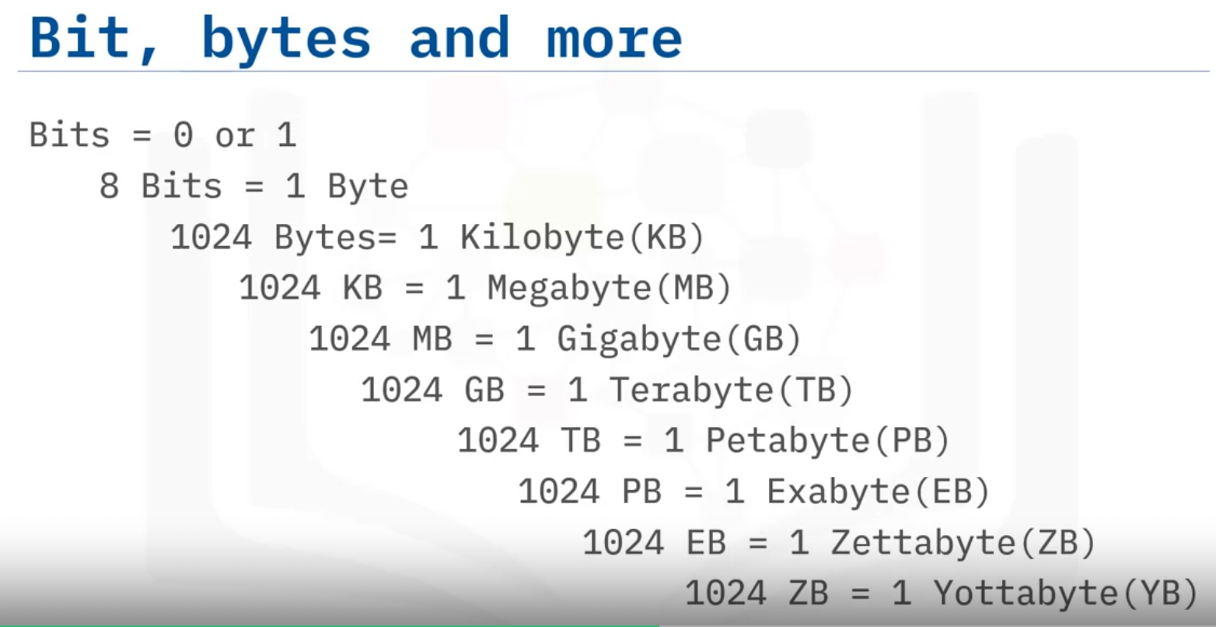

Slide 6
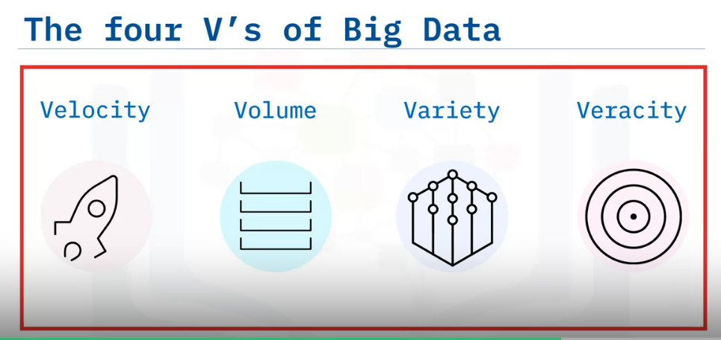
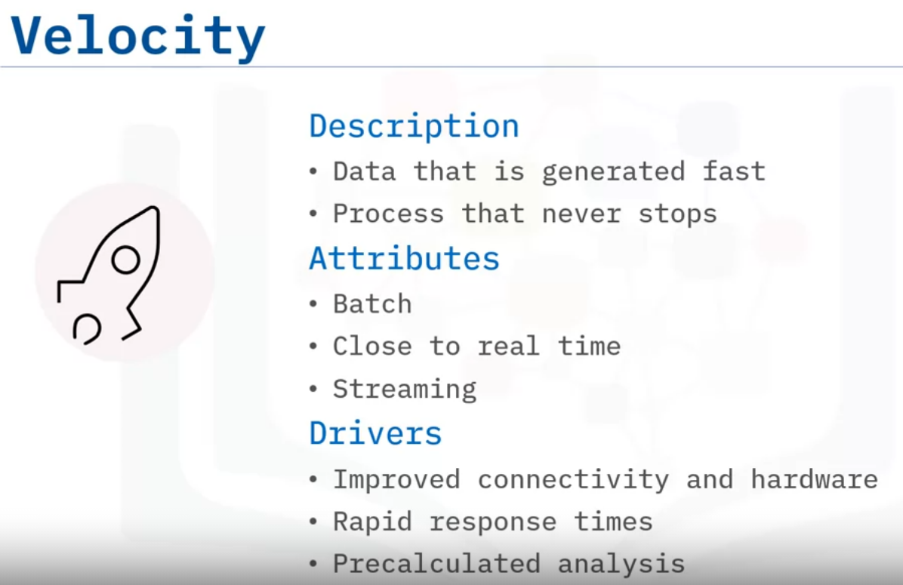
four V’s of Big Data are: Velocity, Volume, Variety, and Veracity.
Velocity is the speed at which data arrives.
Volume is the increase in the amount of data stored over time.
Variety is the diversity of data.
Many forms of data exist and need to be stored.
Veracity is the certainty of data.
With a large amount of data available, how will we know if the data collected is accurate or inaccurate?
These four main components are used to describe the dimensions of Big Data.
Velocity signifies that data is being generated extremely fast, and the process never stops.
Data must be processed quickly so that decisions can be made at the speed with which the data arrives.
Velocity’s main attributes are: batch close to real-time, and streaming.
What are the drivers? Definitely improving connectivity and hardware.
Just think about all the devices that are connected through the Internet today and all the super-fast response times.
Big Data also supports upscaling of pre-calculated analysis.

Slide 7
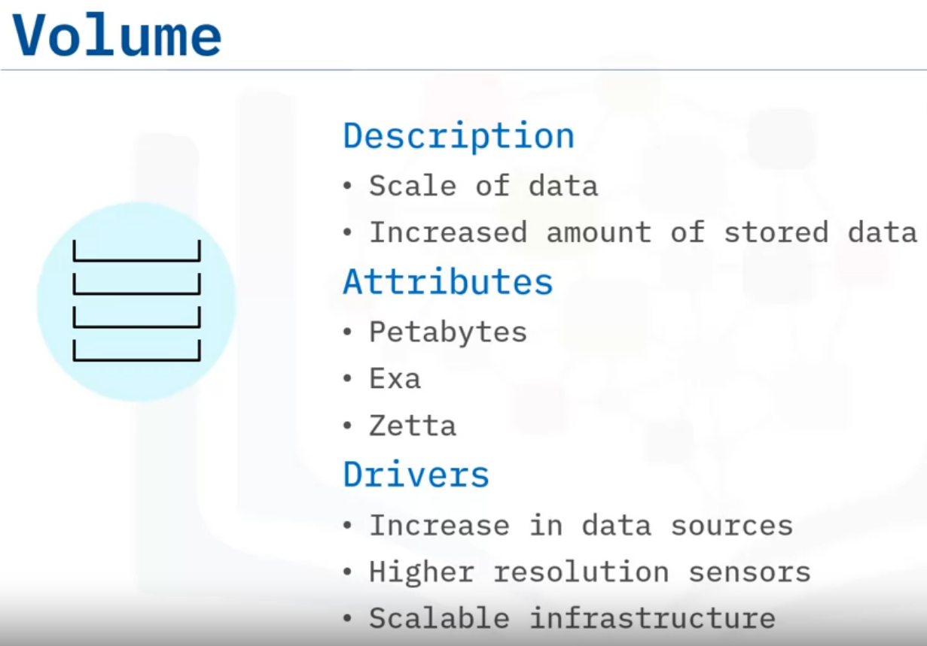
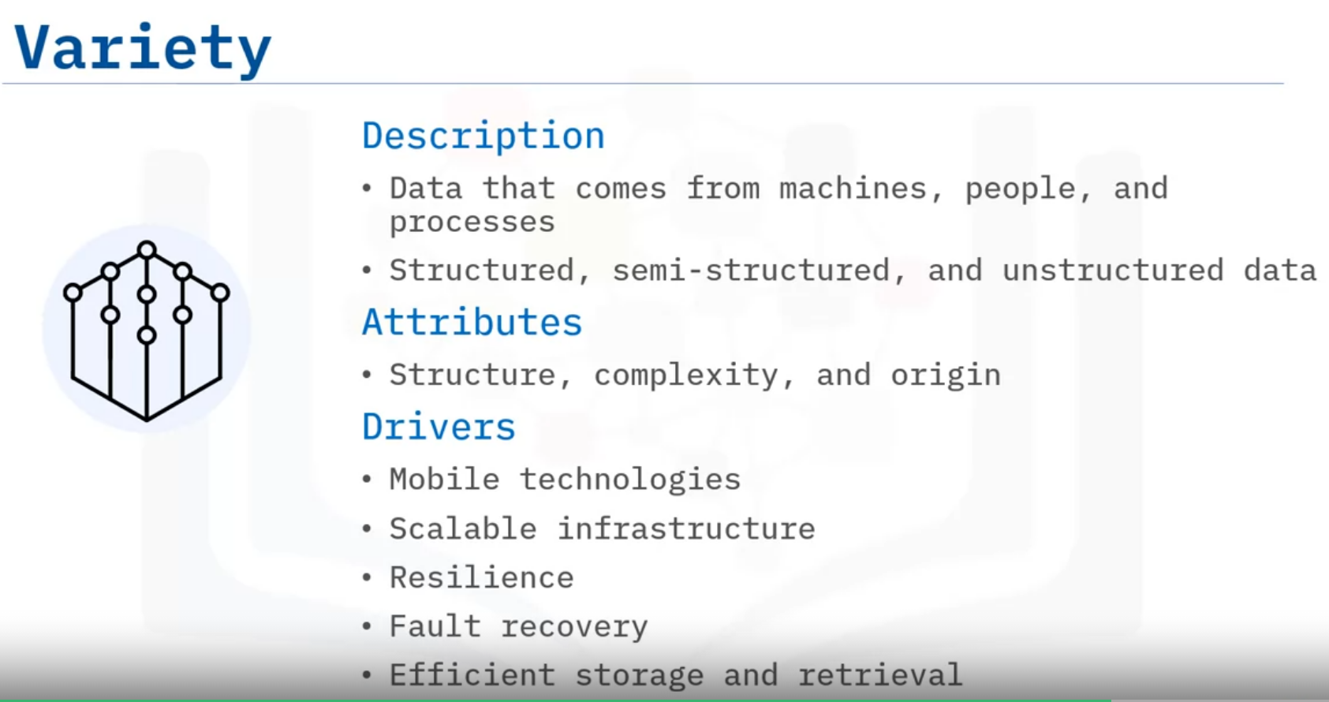
Volume is the increase in the amount of data stored.
The amount of Big Data generated is vast compared to traditional data sources.
Volume attributes of Big Data are: Petabytes, Exa, and Zetta, to name just a few.
Typical drivers of volume in Big Data are: the increase in data sources, higher resolution sensors, and scalable hardware infrastructure.
Variety is the diversity of the data.
Data is generated by people and processes through the use of machines, from both inside and outside an organization.
Some of the data is structured and semi-structured, but most is unstructured.
The main attributes are structure, complexity, and origin.
Drivers of Variety in Big Data can be: mobile technologies, scalable hardware infrastructure, resilience, fault recovery, and efficient storage and retrieval.

Slide 8
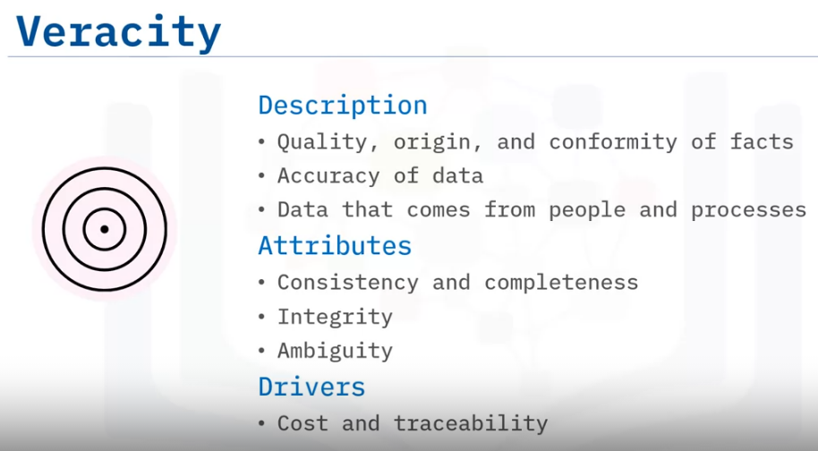
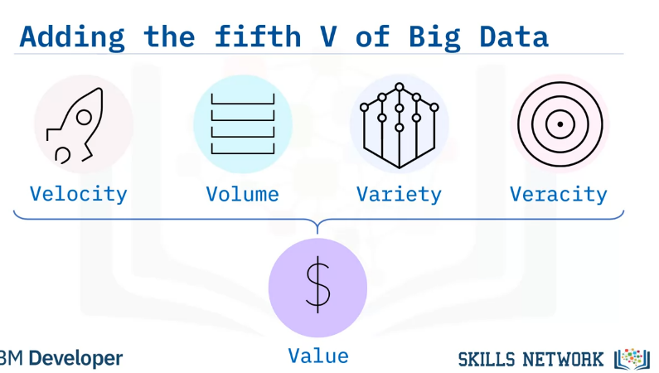
Veracity is the quality, origin, and conformity to facts and accuracy of the data.
This is because data comes from both within and outside an organization.
Attributes include consistency and completeness, integrity, and ambiguity.
Drivers of Veracity in Big Data are: cost and the need for traceability, robust ingestion, and extract, transform, load (ETL) mechanisms.
Big Data has another V that must be considered.
The fifth V of Big Data is Value.
It is the outcome of making intelligent business decisions from leveraging the previous four V’s.
The ultimate goal of an organization is to: produce value in the form of faster and smarter business decisions, increase efficient use of resources, and discover of new market opportunities.
Big Data supports innovation and thus creates value.

Slide 9
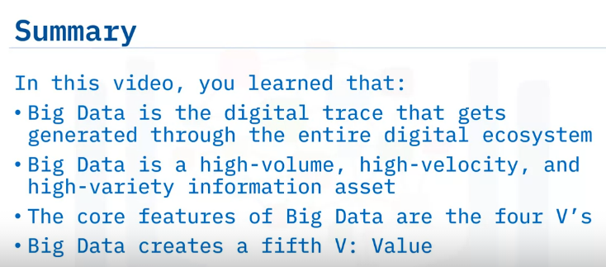

Slide 10
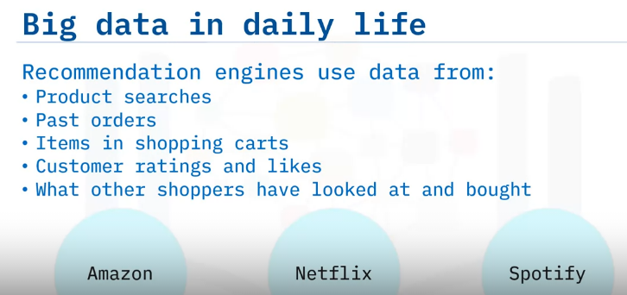
List examples of Big Data related technologies.
Explain the impact of Big Data on businesses and people.
Describe the Internet of Things (IoT) and its impact on Big Data.
Impact of Big Data
Big Data is one of the most important subjects of this century.
Yet globally, millions of people are generating and using Big Data without necessarily being aware of it.
This personal data in the form of photos, videos, and text that people send to each other forms the bulk of data collected by consumer goods companies.
So, it is interesting to consider how Big Data is impacting businesses and people.
Have you ever searched for or bought a product on Amazon?
Did you notice that Amazon’s recommendations are based on what the users have searched for, have bought in the past, the items they have in the virtual shopping cart, items they have rated and liked, and what other customers have viewed and purchased.
Companies like Amazon, Netflix and Spotify use algorithms based on big data to make specific recommendations based on customer preferences and historical behavior.
Recommendation engines are a common application of Big Data.

Slide 11
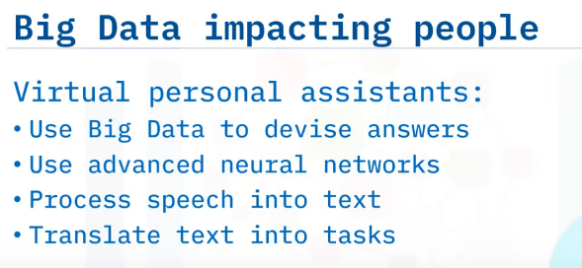
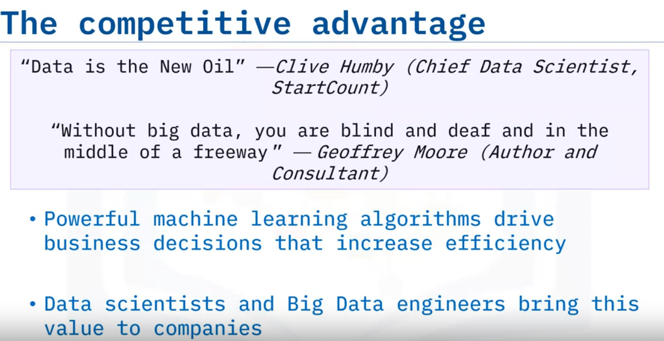
Personal assistants like Siri on Apple devices, or Alexa on Amazon devices, use Big Data to devise answers to the infinite number of questions end-users may ask.
These assistants use some of the most advanced neural networks ever made.
This allows them to process speech into text and translate text into complex tasks that can be carried out across multiple applications within that device.
Sources of Big Data collected for these actions include not only personal data and preferences on-device and in the cloud, but also external factors.
Google Now, for example, makes recommendations before users ask for them, especially when it is linked to the users’ calendars and location and sensing is enabled on the user’s phone.
Google Now knows where the user is, and where they need to be.
It can tell users about things like traffic or the weather before they even ask for it.
In this instance, the collection of Big Data is used to forecast future needs and behavior.
Now that we have an idea of how consumers are using Big Data, let's take a look at how Big Data is impacting businesses.
Clive Humby went as far as to call data the “New Oil” and Geoffrey Moore compared the value of data to our senses of sight and hearing.
Big Data is fundamentally changing the way businesses compete and operate.
Complex and powerful machine learning algorithms drive business decisions that ultimately increase effectiveness.
In recent years the annual demand for data scientists and Big Data engineers is increasing significantly, and the Big Data skillset remains highly valuable to businesses.

Slide 12
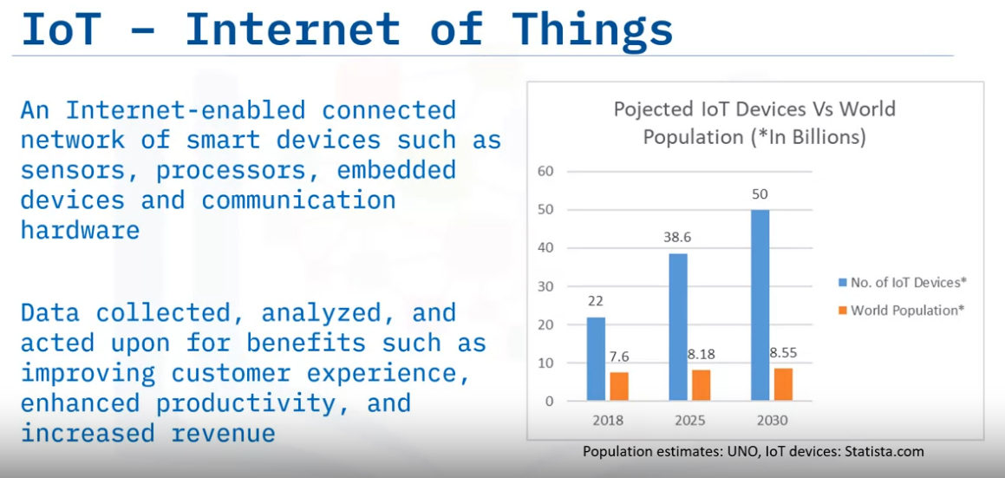
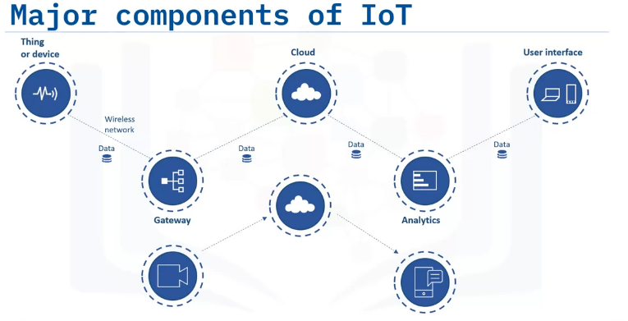
The Internet of Things (IoT) refers to a system of physical objects that are connected through the Internet.
A “thing or device” can include a smart device in our homes, or a personal communication device such as a smartphone or computer.
These collect and transfer massive amounts of data over the Internet without any manual intervention by using embedded technologies
All of these devices gather, analyze, share, and transmit data in real time.
Without Big Data, IoT devices would not hold the functionalities and capabilities which have gained them so much attention globally.
Following Statista’s forecast, we will see four times more IoT devices than the total number of the entire world population by 2030.
Let’s look at major components of the IoT ecosystem.
An Internet-enabled connected network of systems, that comprise smart devices and sensors, constantly produce and transmit a variety of data.
This Big Data is passed through a Gateway that routes it to its destined storage in the Cloud.
Data Engineers use sophisticated algorithms to make sense of this collected Big Data and compile it into an analytical form that can be interpreted by humans.
The analyzed data is then used to make business and consumer decisions to enhance the customer experience and to enhance productivity.
For example, a security camera could continually upload footage, and a cloud-based big data algorithm may alert the user if any activity is detected

Slide 13
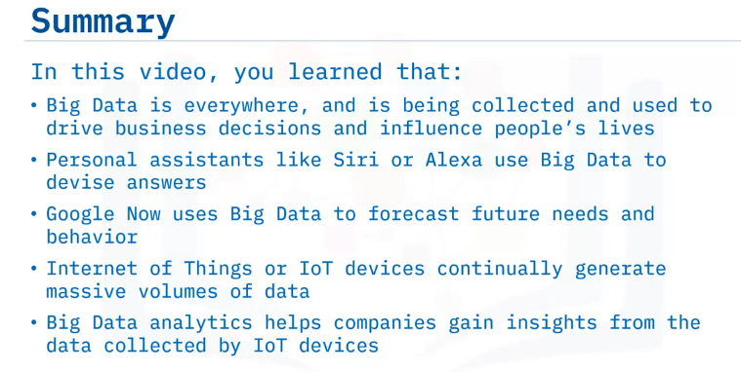

Slide 14
Explain why Big Data requires parallel processing.
Identify the differences between linear and parallel processing.
Identify why parallel processing is apt for Big Data.
Explain parallel processing and scalability.
Describe the motivation for horizontal scaling.
Demonstrate “embarrassingly parallel.”
Explain fault tolerance in parallel computing.
Parallel Processing, Scaling, and Data Parallelism
You can do lots of things with data at various sizes, right?
In any normal analytics cycle, the functionality of the computer is to store data and move that data from its storage capacity into a compute capacity (which includes memory), and back to storage once important results are computed.
With Big Data, you have more data than will fit on a single computer.

Slide 15
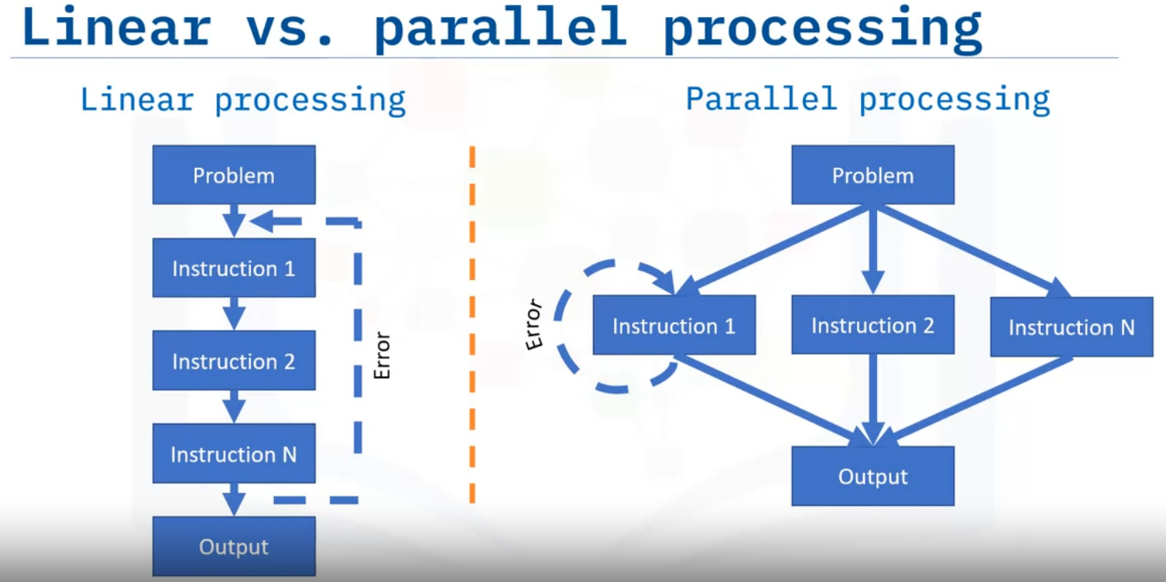
Parallel processing can best be understood by comparing it to Linear processing.
Linear processing is the traditional method of computing a problem where the problem statement is broken into a set of instructions that are executed sequentially till all instructions are completed successfully.
If an error occurs in any one of the instructions, the entire sequence of instructions is executed from the beginning after the error has been resolved.
It is evident from the processing method that Linear processing is best suited for minor computing tasks and is inefficient and time consuming when it comes to processing complex problems such as Big Data.
Parallel Processing The alternative to Linear processing is parallel processing.
Here too, the problem statement is broken down into a set of executable instructions.
The instructions are then distributed to multiple execution nodes of equal processing power and are executed in parallel.
Since the instructions are run on separate execution nodes, errors can be fixed and executed locally independent of other instructions.

Slide 16
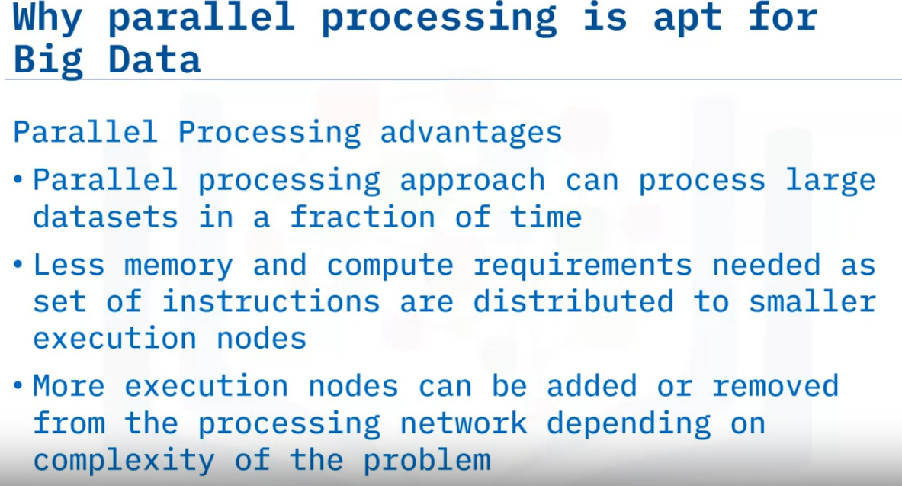
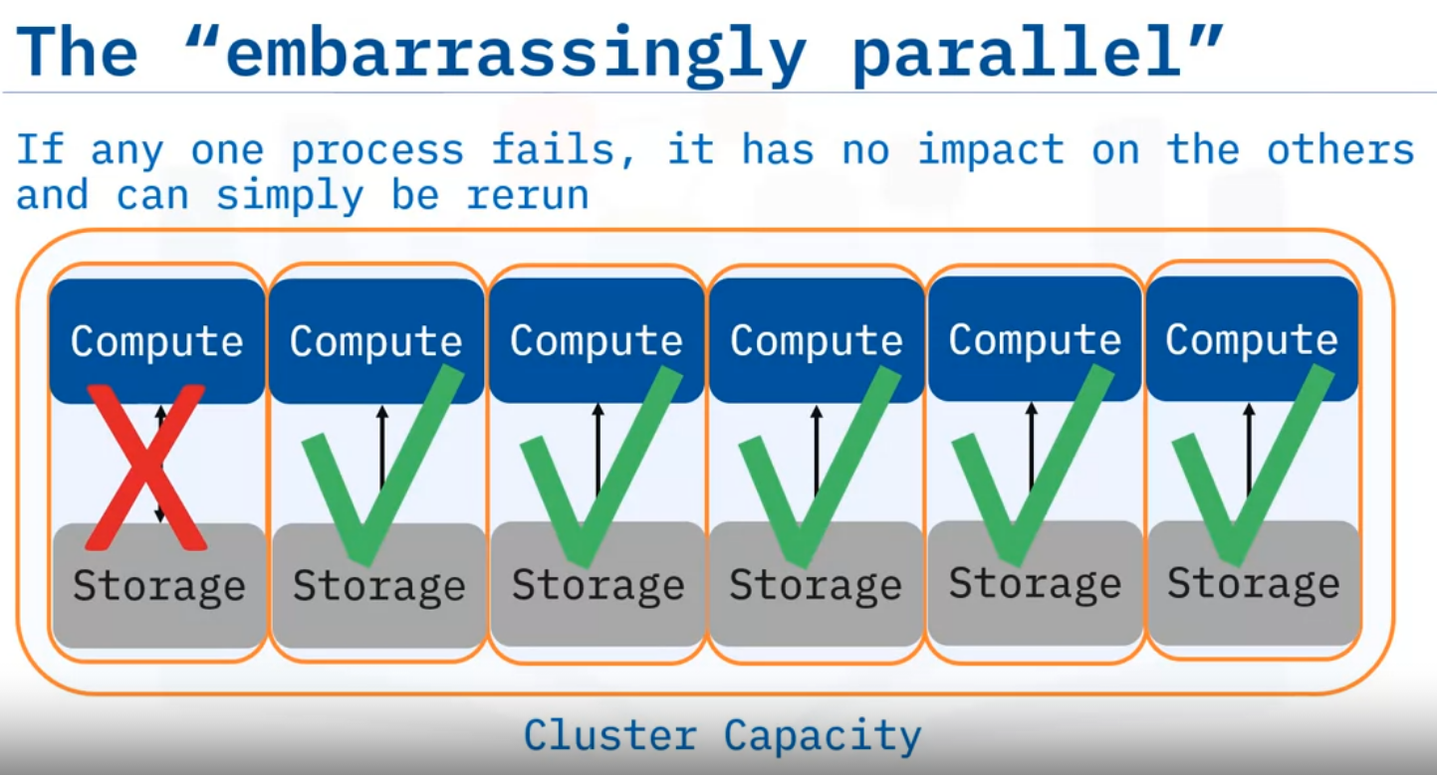
Parallel processing offers significant advantages when dealing with complex problems such as Big Data.
Some of the other benefits of using Parallel processing are:.
1. Reduced processing times : Parallel processing can process Big Data in a fraction of the time compared to linear processing.
2. Less memory and processing requirements : Since the problem instructions are executed on separate execution nodes, memory and processing requirements are low even while processing large volumes of data.
3. Flexibility : The biggest advantage of parallel processing is that execution nodes can be added and removed as and when required. This significantly reduces infrastructure cost.
Data Scaling is a technique to manage, store, and process the overflow of data.
You can get a larger single node computer.
But when your data is growing exponentially, eventually it will outgrow the capacity that is available.
Increasing the capacity of a single node as a means of increasing capacity is called scaling up.
A better strategy, or at least the one most people ultimately choose, is to scale out or to scale horizontally.
This simply means adding additional nodes with the same capacity until the problem is tractable.
The individual nodes arranged in this way are called a computing cluster.
Compute clusters can solve problems that are known as “embarrassingly parallel” calculations.
These are the kind of workloads that can easily be divided and run independent of one another.
If any one process fails, it has no impact on the others and can easily be rerun.
An example would be to, say, change the date format in a single column of a large dataset that has been split into multiple smaller chunks that are stored in different nodes of the cluster.

Slide 17
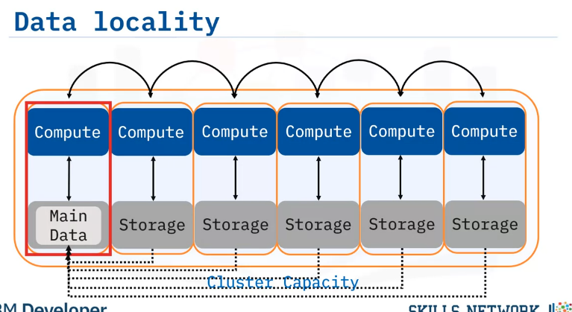
Now, the multiple computations must coordinate with one another because each process needs to be aware of the state of its peer processes in order to complete the calculation.
This requires sending messages across a network to each other or writing them to a file system that is accessible to all processes on the cluster.
The level of complexity increases significantly, because you are basically asking a cluster of computers to behave as a single computer.
Most calculations in enterprise environments are considered “embarassingly parallel with some not so easy” calculations.
While this statement is true to varying degrees it has guided the design of underlying frameworks.
In the Hadoop ecosystem, the concept of “bringing compute to the data” is a central idea in the design of the cluster.
The cluster is designed in a way that computations on certain pieces, or partitions, of the data will take place right at the location of the data when possible.
The resulting output will also be written to the same node.

Slide 18
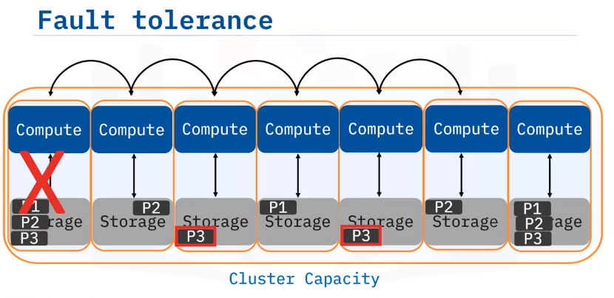
Computers break, outages happen, and you need to be prepared.
In such cases, fault tolerance comes into play.
Fault tolerance refers to the ability of a system to continue operating without interruption when one or more of its components fail.
This works for Hadoop primary data storage system (HDFS) and other similar storage systems (like S3 and object storage), a system like the one we showcase here.
Consider the first 3 partitions of a data set labelled P1, P2, and P3, which reside on the first node.
In this system, copies of each of these data partitions are also stored on other locations or nodes within the cluster.
If the first node ever goes down, you can add a new node to the cluster and recover the lost partitions by copying data from one of the other nodes where copies of P1, P2, and P3 partitions are stored.
Clearly, this is an extraordinarily complex maintenance process, but the Hadoop filesystem is a robust and time-tested framework. It can be reliable to 5 9s (99.999%).

Slide 19
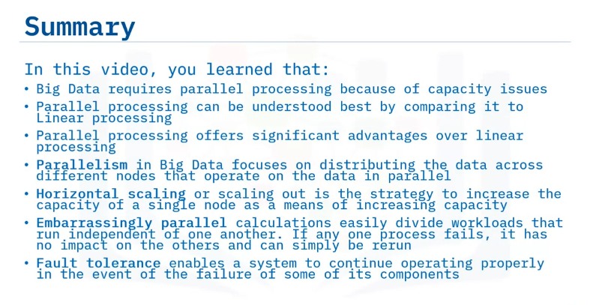

Slide 20
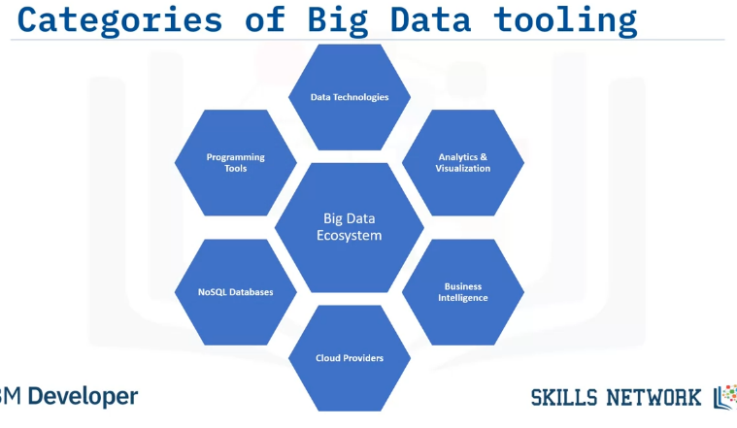
Identify the key tooling categories within the Big Data ecosystem
Describe the role of each tooling category in the Big Data life cycle
List major tools and vendors within each Big Data tooling category
Big Data Tools and Ecosystem
Big Data tools have six different categories:
Data Technologies
Analytics and Visualization
Business Intelligence
Cloud service providers
NoSQL Databases; and
Programming Tools

Slide 21
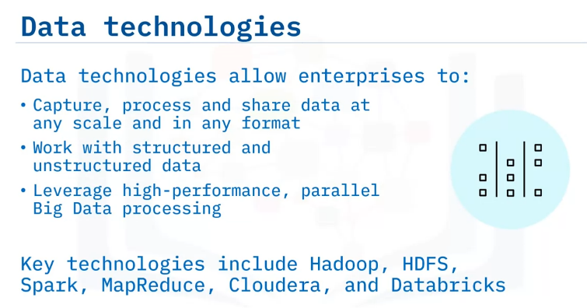
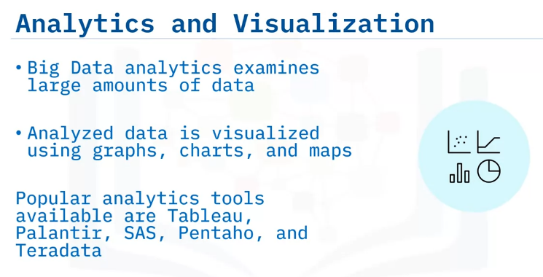
Data technologies are specially designed to analyze, process, and extract meaningful information from Big Data.
These functions are beyond the capabilities of traditional data processing tools.
These technologies capture, process, and share Big Data work with structured and unstructured data, and offer high-performance, parallel processing of Big Data.
Data technologies for Big Data are dominated by open source projects including Apache Hadoop, Apache HDFS, and Apache Spark.
Major commercial vendors such as Cloudera and Databricks contribute to and support these projects.
Data Analytical tools examine large amounts of data to uncover hidden patterns, correlations, and trends.
Data visualization, on the other hand provides a visual representation of these trends in the form of graphs, charts, and maps.
These tools provide an accessible way to view and understand trends, outliers, and patterns in data.
Tableau, Palantir, SAS, Pentaho, and Teradata are leading examples of analytics and visualization tools

Slide 22
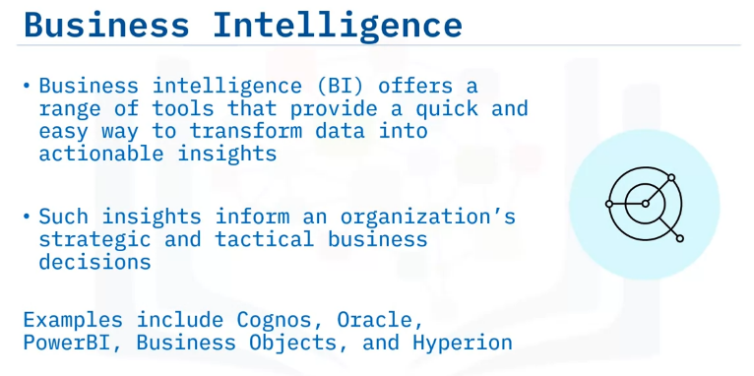
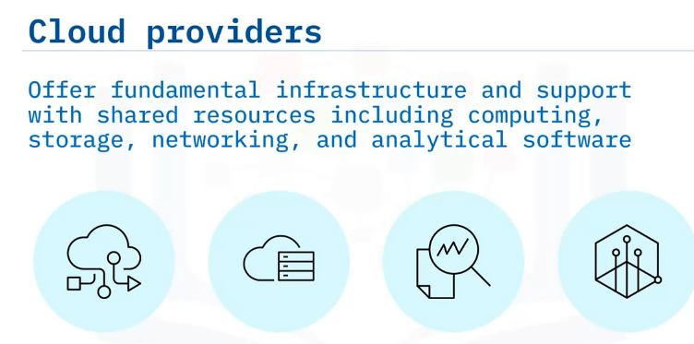
It is not enough to only analyze the visualized data.
Business Intelligence tools transform raw data into meaningful, actionable information that is suitable for business analysis.
Business intelligence techniques also involve basic mathematical concepts such as probability, statistics, and flowcharts.
The insights gained from Business Intelligence help drive business decisions.
Some examples of BI tools are Cognos, Oracle, PowerBI, Business Objects, and Hyperion.
Big Data presents challenges to storing, transporting, processing, mining, and serving enormous amounts of data.
Cloud providers offer fundamental infrastructure and support with shared computing resources including computing, storage, networking, and analytical software.
Cloud providers also provide “software as a service” models with point solutions to allow enterprises to easily aggregate, process, and visualize data.
Examples of Cloud service providers include AWS, IBM, GCP, and Oracle.

Slide 23
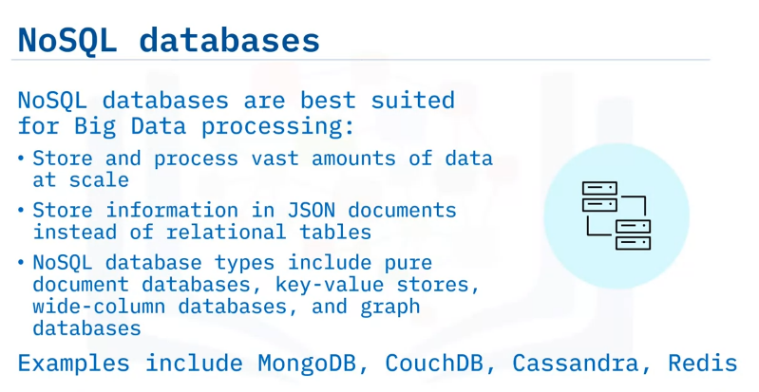
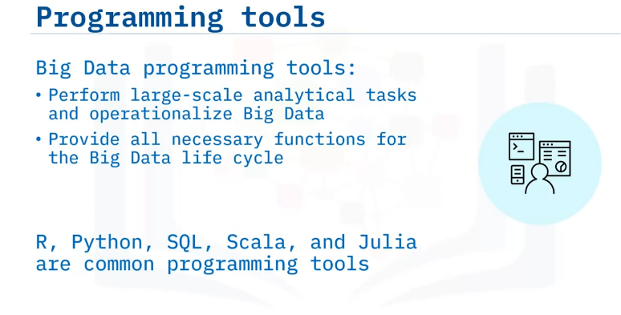
Another key component of Big Data commercial tools are NoSQL Databases that are tailor made for Big Data processing.
NoSQL databases are built from the ground up to store and process vast amounts of data at scale and support a growing number of modern businesses.
NoSQL databases store data in documents rather than relational tables.
Types of NoSQL databases include pure document databases, key-value stores, wide-column databases, and graph databases such as MongoDB, CouchDB, Cassandra, and Redis.
Programming tools are the final component of Big Data commercial tools.
These programming tools:
Perform large-scale analytical tasks and operationalize Big Data.
They also provide all necessary functions for data collection, cleaning, exploration, modeling, and visualization.
Some popular tools you can use for programming include R, Python, SQL, Scala, and Julia.

Slide 24
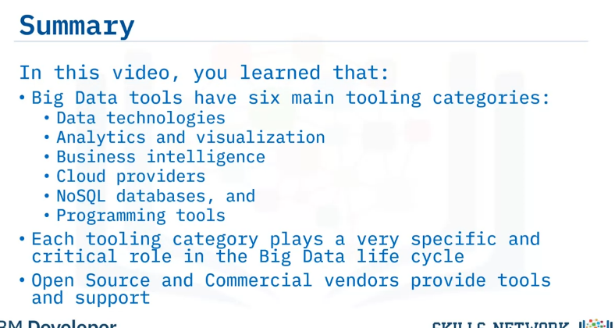

Slide 25
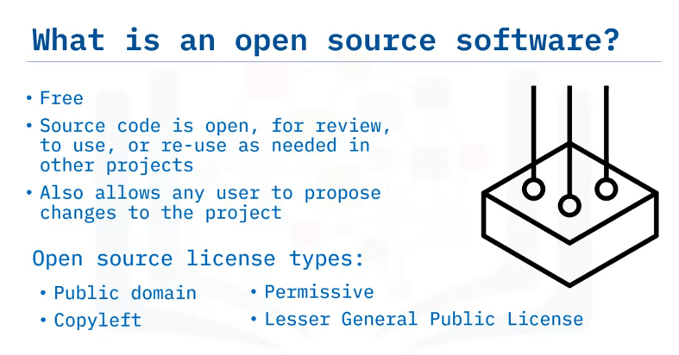
Open Source and Big Data
Explain the role of open source in Big Data.
Describe platforms for coordinating open source.
Describe the most popular open-source frameworks.
A simple definition of an open source software is that it is free.
Not only is the runnable version of the code free, but the source code is also completely open, meaning that every line of code is available for people to view, use, and reuse as needed.
However, A project becomes truly open source once it embraces the open-governance model.
This action ensures that any contributor from any organization can propose changes to the code and the overall project can be steered to serve the community’s needs.
It is important to note that not all open source software is the same.
The type of license associated with the software prescribes how you can use it.
Before using any open source software, it is important to check for the type of license it is available under, and to understand the permissions available under the specific license type.

Slide 26
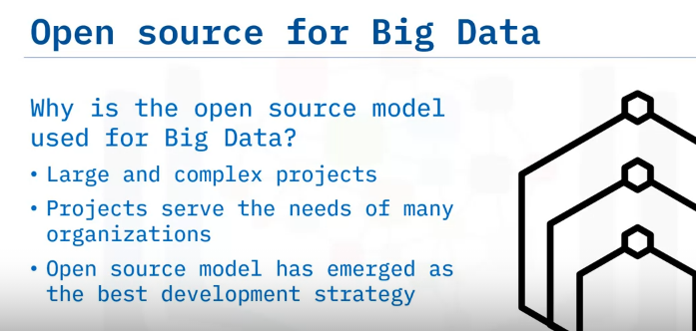
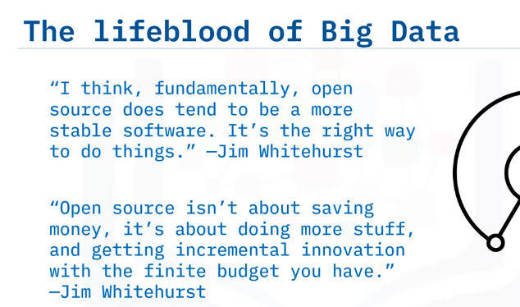
Accordingly, we need to ask “why is the open source model used for Big Data?”
Open source projects are massive efforts.
While many projects are started within one organization, the truly open source projects persist beyond the efforts of any single organization.
These projects form the foundation of all of the modern Big Data infrastructure.
Consider the Linux Kernel. When Linus Torvalds first began developing this kernel as an open source, there were many players in the operating system space, and many were offering only proprietary versions of their code.
It was not clear at the time who would ultimately emerge as the OS standard. Nearly 30 years later, Linux is the standard for all servers.
This is true for almost every data server in every part of the world, regardless of hardware, software, or service provider.
This happened because the project took on a life of its own, beyond any single company’s interest, and persists beyond any one organization’s cycles of interest.
The open-source development model is to software development what democracy is to the government.
It is the most transparent way to conduct a project, and ultimately serves the will of the people participating in it.
In some senses it is a surprising result that a completely open model will ultimately be a more profitable solution.
But this has proven to be the case time and time again, and we now embrace the model without controversy

Slide 27
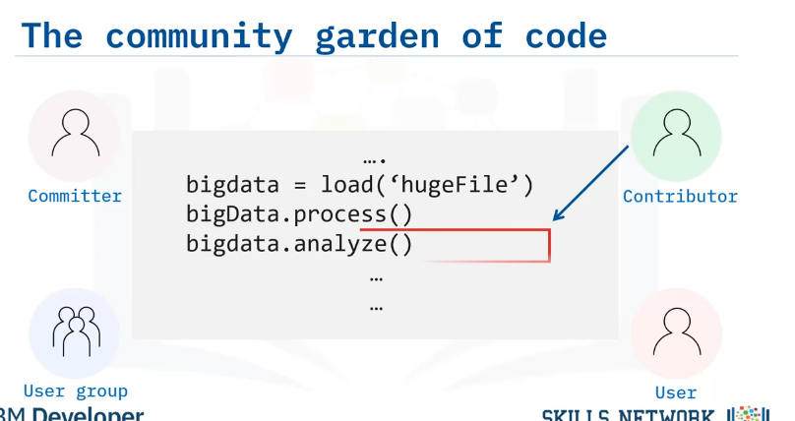
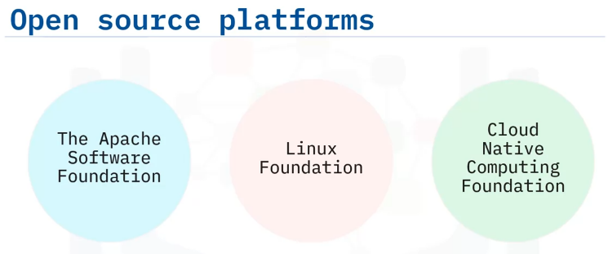
Most open source projects have formal processes for contributing to code, and also include various levels of influence and obligation to the project.
Committer, contributor, user, user group.
Typically, committers have the ability to modify the code directly, while contributors submit their code for review (by a committer) before the code is modified.
Many more people are simply users of the code.
Most, but not all, major open source projects belong to one of the major open source foundations, and follow a similar governance procedure.
Open source means that the code is freely visible, which is an important distinction from proprietary software.
Open governance, however, is what makes the project truly open and democratic.
Open source foundations prescribe best practices for open source development as well as open governance.

Slide 28
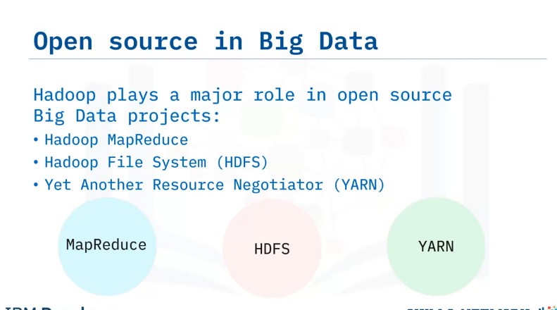
The biggest component of big data is, by far, the Hadoop project and its three main components: MapReduce, The Hadoop File System (HDFS), and The resource manager (YARN).
MapReduce is a framework that allows code to be written to run at scale on a Hadoop cluster.
It is still used, but not as much as more modern Big Data computation frameworks like Apache Spark.
HDFS is the file system that stores and manages Big Data files.
It manages all of the issues around large and distributed datasets, including resilience and partitioning.
It is still a mainstay of the industry.
70% of the world’s Big Data resides on HDFS.
More modern approaches to distributed storage, such as S3 and object storage, are coming into use, but they are based on the design principles of HDFS.
YARN is the resource manager that comes with Hadoop, and it is the default resource manager for many Big Data applications, including HIVE and Spark.
It is one of the most robust resource managers in use today, but more modern container-based resource managers (like Kubernetes) are slowly becoming the new de facto standards.
Concluding, these are the main components of the Hadoop ecosystem, and most big data applications are built on top of them.

Slide 29
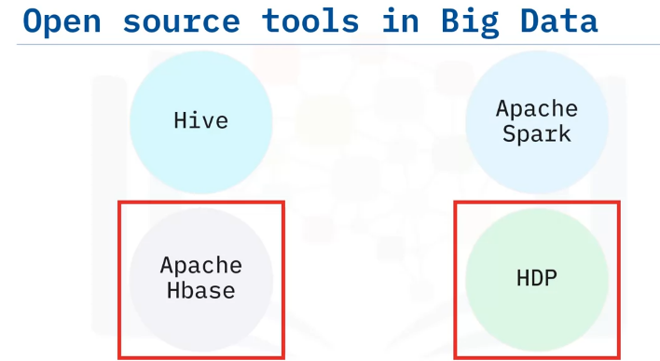
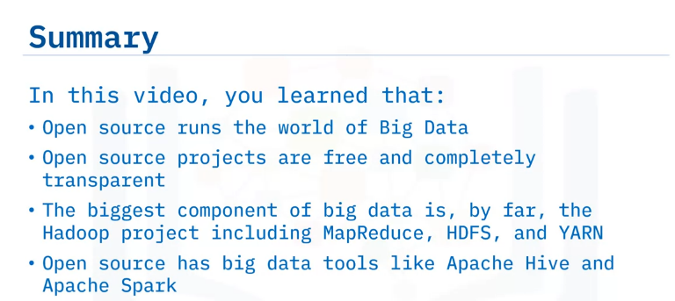
The array of big data applications available to the user is dizzying.
They all build upon the basic Hadoop framework or interact with it in some way, however.
Frameworks like Hive and Spark support lots of ETL (Extract, Transform, Load) and computation tasks on Hadoop systems.
Some systems that integrate tightly with the Hadoop ecosystem are: Apache Hbase, which is a large NoSQL datastore.
It manages storage and computation resources outside of the Hadoop ecosystem but often resides on the same cluster.
Open-source packages like the Hortonworks Data Platform (HDP) provide a set of big data tools that are already configured to work together, and include most of the important open source packages (Hadoop, Spark, Hive, Hbase, and others).

Slide 30
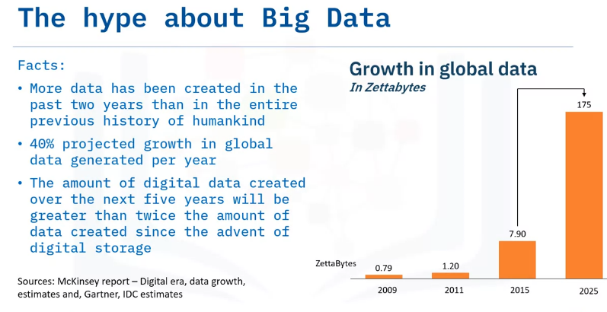
Beyond the Hype
Describe facts about big data.
Describe the key sources of Big Data.
Explain different types of Big Data.
Describe the contribution of cloud computing in big data.
So why is everyone talking about Big Data?
More data has been created in past two years than in the entire previous history of humankind.
There is a 40% projected growth in global data generated per year.
By 2026, the amount of digital data created will exceed twice
the amount of data created since the advent of digital storage.
The chart on the right shows the growth in global data in zettabytes.

Slide 31
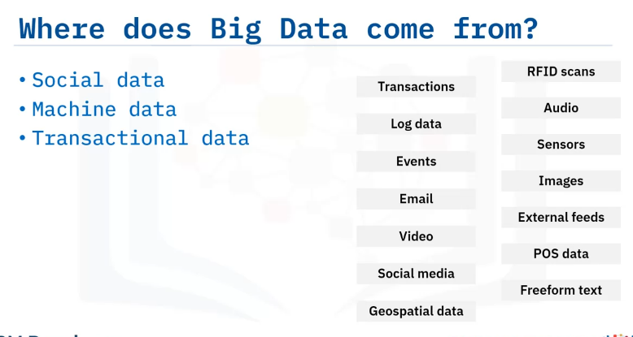
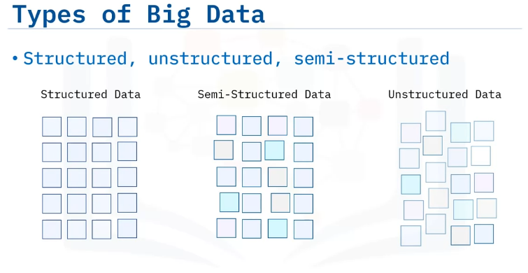
There are three major sources of Big Data.
Social data comes from the likes, Tweets &amp; Retweets, comments, video uploads, and general media that are uploaded and shared via the world’s favorite social media platforms.
Machine-generated data and business-generated data, are data that organizations generate within their own operations.
Machine data is defined as information which is generated by Internet of
Things (IoT) sensors equipped industrial equipment that are installed in machinery, and even web logs that track user behavior.
Transactional data is generated from all the daily transactions that take place both online and offline, such as invoices, payment orders, storage records, delivery receipts.
Big Data comes in three types: structured, semi-structured, and unstructured data.
Structured data is data that is organized, labeled, and has a pre-defined data model that conforms to a tabular format.
Common examples of structured data include names, dates, addresses, and credit card numbers.
Unstructured data is said to make up about 80% of data in the world and does not conform to any predetermined format.
It includes images, audio or video files, sensor data from IoT devices, text messages, and social media posts.
Semi-structured data includes components of both structured and unstructured data in that it is mostly unstructured, but includes some metadata that identifies certain characteristics.
Emails fall into the category of semi-structured data because, while the content in an email is usually unstructured, there are several characteristics such as the email addresses, subject line, logo images, and URLs that can be pulled into structured tables.

Slide 32
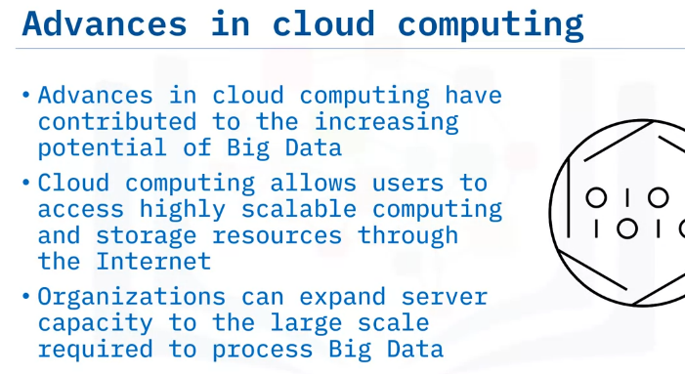
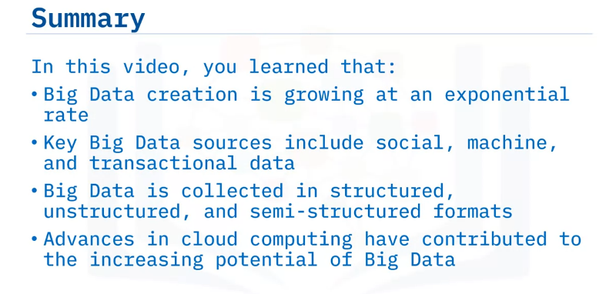
Some sources of structured Big Data are relational databases and spreadsheets.
With this type of structure, we know how data is related to other data, what the data means, & the data is easy to query using a programming language like SQL.
Some sources of semi-structured Big Data are XML and JSON files.
These sources use tags or other markers to enforce hierarchies of records and fields within data.
Currently, there is an explosion of data coming from Internet activity, and in particular, video production and consumption as well as social media activities.
These numbers will just keep growing as Internet speeds increase, and as more and more people all over the world have access to the Internet.
The emergence of cloud computing has contributed significantly to the launch of the Big Data era: Cloud computing allows users to access highly scalable computing and storage resources through the Internet.
By using cloud computing, companies can use server capacity as needed, and expand it rapidly to the large scale required to process big data sets and run complicated mathematical models.
Cloud computing lowers the price to analyze big data as the resources are shared across many users, who pay only for the capacity they actually use.

Slide 33
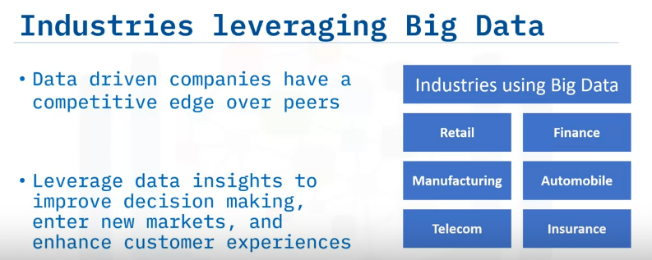
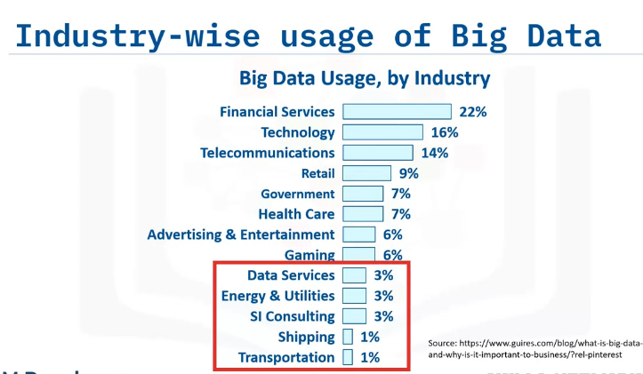
Identify industries where Big Data is leveraged
Discuss and outline the usage of Big Data in key industries
Big Data Use Cases
Data is getting generated at unprecedented volumes and data driven companies can develop a competitive edge over their peers if the data can be aggregated and analyzed effectively to generate breakthrough insights.
Every major industry is taking advantage of data insights to improve decision-making, enter new markets, and deliver better customer experiences.

Slide 34
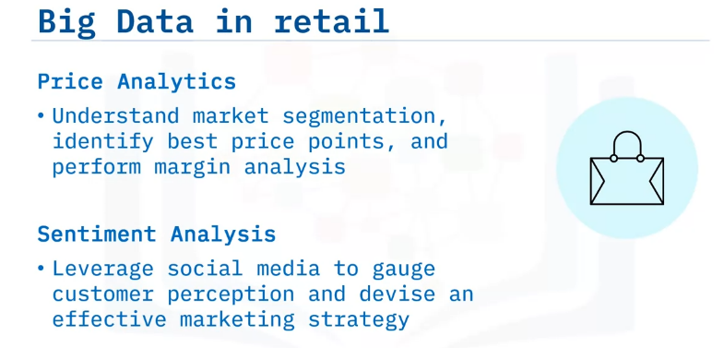
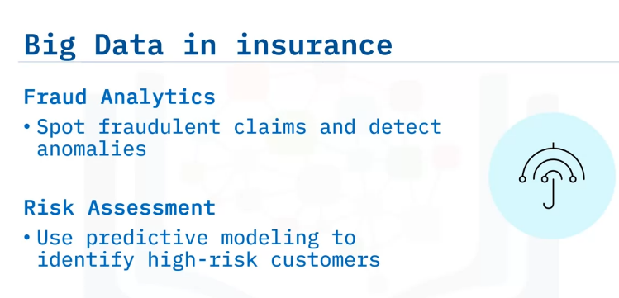
In the retail industry key uses of Big Data include price analytics and sentiment analysis.
Price analytics helps understand market segmentation, identify the best price points for a product line, and perform margin analysis for maximum profitability.
On the other hand, sentiment analysis leverages social media conversations to understand what consumers think of a product, and subsequently to devise an effective marketing strategy to connect with the customers.
Insurance companies use Big Data for fraud analytics.
Big Data helps them spot fraudulent claims and detect any anomalies in trends and prevent suspicious activities.
Insurers also perform risk assessments using Big Data.
For example, they may use predictive modelling based on user history and behavioral analytics to identify customers at higher risk of getting into accidents or having their vehicle stolen.

Slide 35
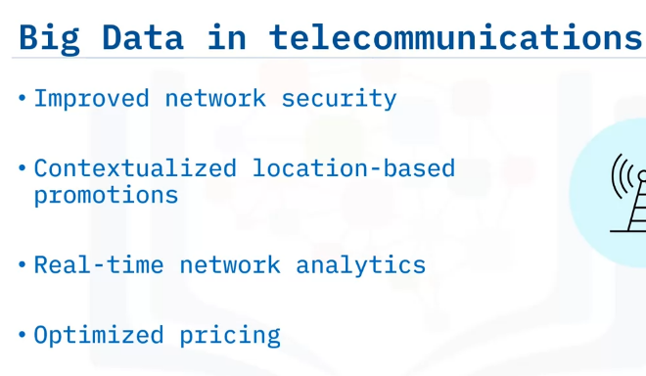
Telecom companies are some of the top users of Big Data analytics.
They use Big Data for improved network security.
Machine learning-based pattern analysis identifies any threats to the network, and predictive maintenance resolves these threats before any serious damage to the network.
Contextualized promotions based on user locations are another way telecoms leverage Big Data.
For example, if a user is near a specific restaurant around lunch time, they may receive a discount coupon for that restaurant, thereby increasing conversion rates.
Telecoms continuously monitor their network for traffic patterns that would soon impact customer experience.
Analytics alerts them on when is the right time to upgrade the network, thereby helping them focus investment for maximum returns.
Telecoms also run pricing promotions based on real-time factors.
These promotions are tested with targeted customer groups to produce optimized pricing packages

Slide 36


In manufacturing, Big Data helps with predictive maintenance of machines.
The data from the sensors are used to analyze equipment usage patterns to predict equipment failure, maintenance requirements, and parts replacement.
Big Data is also used optimize production by using AI algorithms to understand production lines and recommend optimizations where production time is higher than necessary.
From supply chain analytics to targeted marketing, traffic management and insurance premiums, the automotive industry relies heavily on Big Data.
Automobile service is a high-revenue area for manufacturers.
Companies are predicting breakdowns and bringing in customers for repairs based on sensor data.
Pre-emptive parts ordering reduces customer wait times and increases customer satisfaction.
Real-time data harnessed from connected cars is driving the self-driving car and truck industry.
The vehicle can make real-time adjustments to speed and direction based on the data it constantly gathers from its surroundings.

Slide 37


Like the insurance companies, financial companies use Big Data for fraud detection and risk assessment.
Other use cases for Big Data in finance include: Customer segmentation.
By grouping customers into distinct segments such as demographics, periodicity of transactions,
social media and customer service interactions, companies offer deeply personalized and targeted solutions to their customers.
Algorithmic trading is another major area where Big Data is used extensively. Often, financial transactions are time-sensitive and use mathematical predictive models.
Therefore, these are the perfect candidates to apply machine learning to make quicker and constantly improving decisions.

Slide 38
Summary & Highlights
In this module, you learned that:
Personal assistants like Siri, Alexa and Google Now, use Big Data and IoT to gather data and devise answers.
Big Data Analytics helps companies gain insights from the data collected by IoT devices.
Big Data requires parallel processing on account of massive volumes of data that are too large to fit on any one computer.
"Embarrassingly parallel” calculations are the kinds of workloads that can easily be divided and run independently of one another. If any single process fails, that process has no impact on the other processes and can simply be re-run.
Open-source projects, which are free and completely transparent, run the world of Big Data and include the Hadoop project and big data tools like Apache Hive and Apache Spark.
The Big Data tool ecosystem includes the following six main tooling categories: data technologies, analytics and visualization, business intelligence, cloud providers, NoSQL databases, and programming tools.

